Slide 1
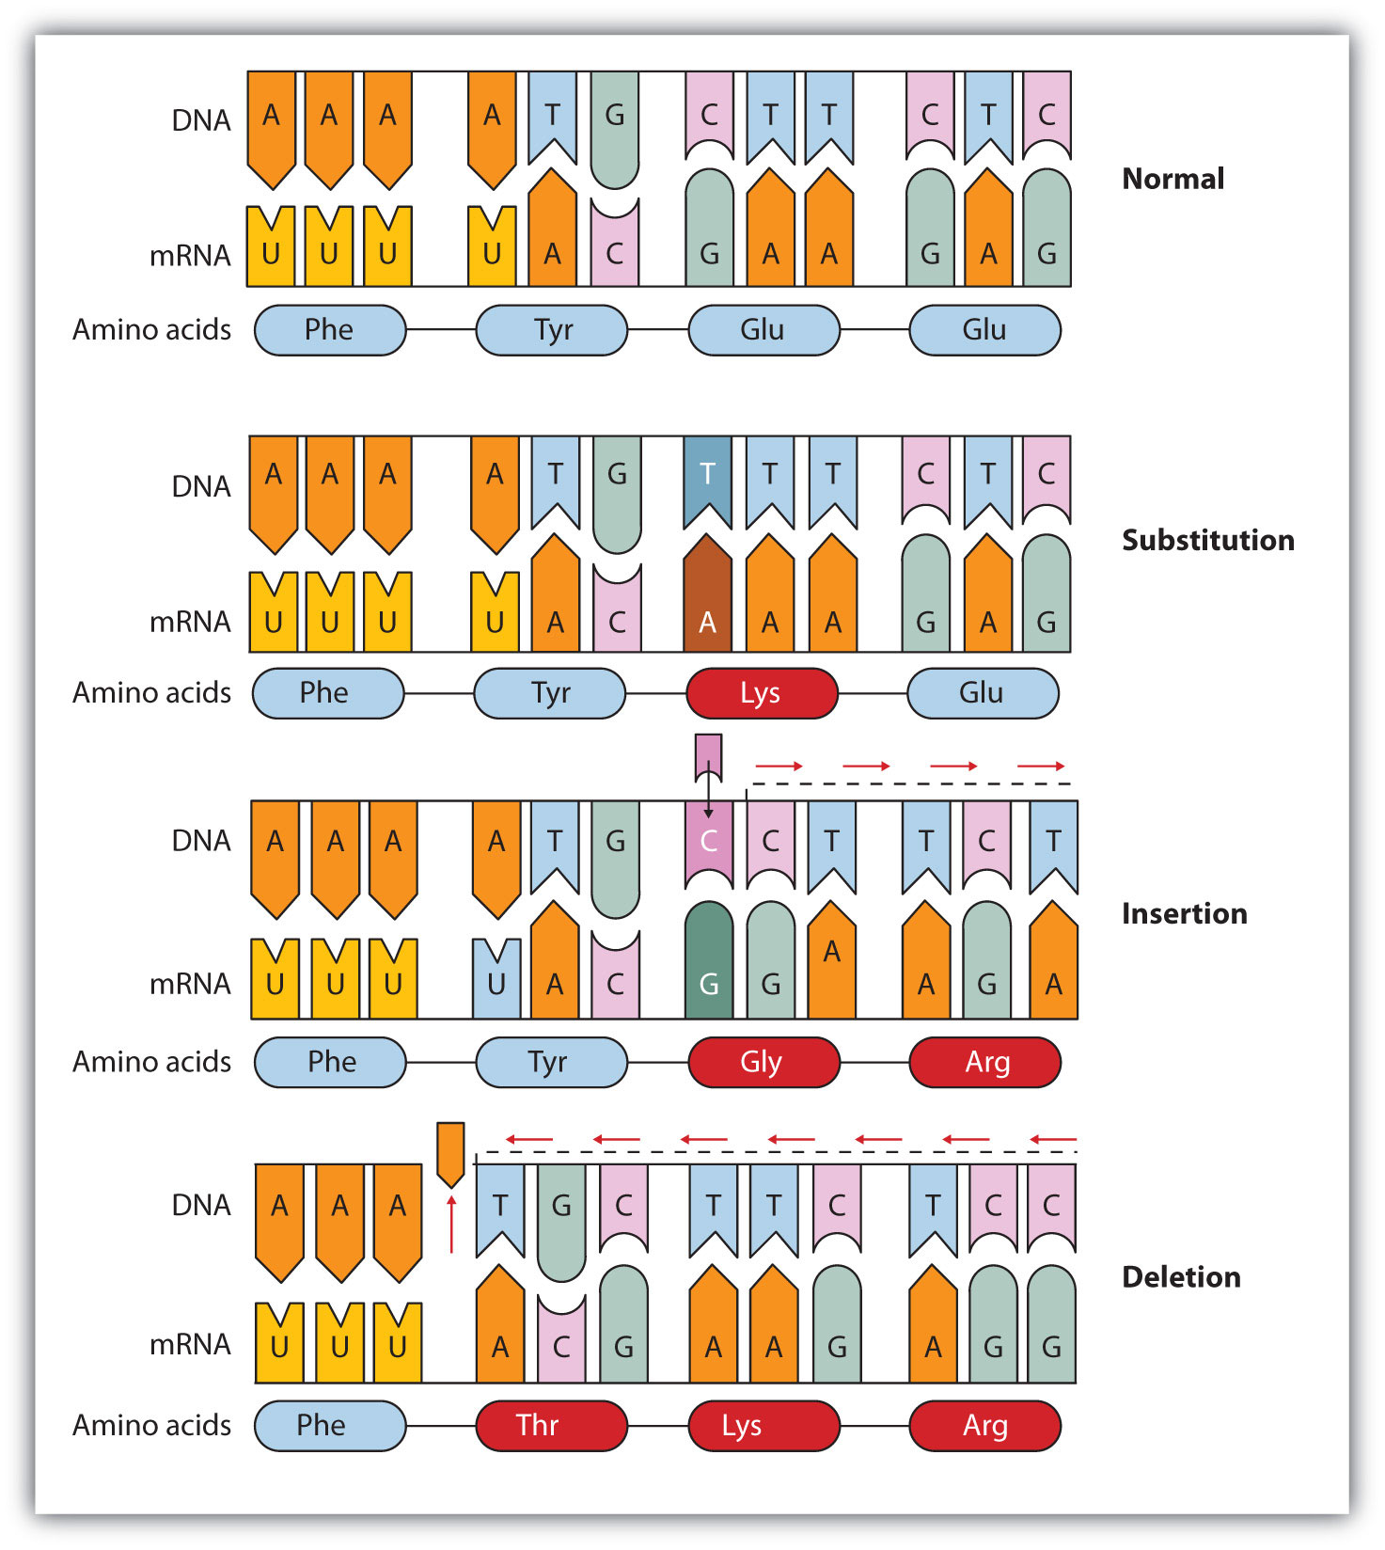
Gene Mutations
Dr. Mahavir Gosavi

Slide 2
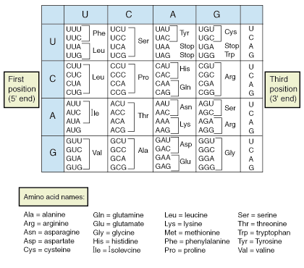

Slide 3
MUTATION
Any sudden change occurring in hereditary material is called as mutation.
They may be harmful, beneficial or neutral.
DNA is highly stable molecule that replicates with amazing accuracy some errors of replication do occur.
A gene mutation is defined as an alteration in the sequence of nucleotides in DNA.
This change can affect a single nucleotide pair or larger gene segment of a chromosome.

Slide 4
Types of Mutations

Slide 5
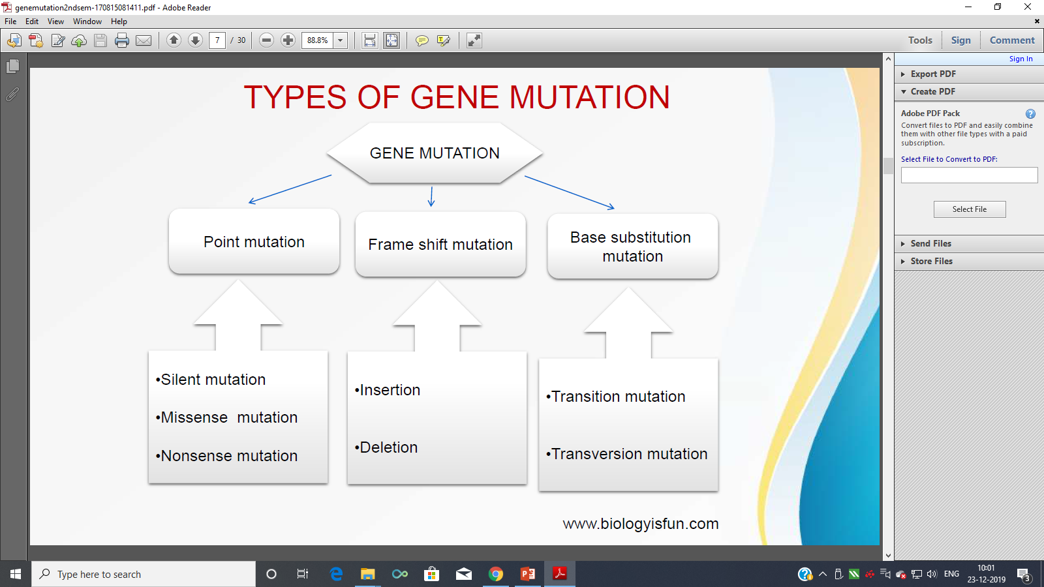

Slide 6
BASE SUBSTITUTION MUTATION
Base substitution are mutation in which one base pair is replaced by another.
Base substitutions can be divide into two subtype:-
Transition mutation
Transversion mutation

Slide 7
TRANSITION MUTATION /TRANSVERSION MUTATION
A transition is the replacement of a base by the other base of the same chemical.
A transversion is the opposite the replacement of a base of one chemical category by a base of the other.

Slide 8
BASE SUBSTITUTION
WILD | MUTANT
3’TAAGGATCTCTTTCTCAA5’ DNA | 3’TACGGATCTCTTTCTCAA5’ DNA
5’AUUCCUAGCGAAAGAGUU3’mRNA | 5’AUGCCUAGCGAAAGAGUU3’mRNA
WILD | MUTANT
3’TAAGGATCTCTTTCTCAA5’ DNA | 3’TAAGGGTCTCTTTCTCAA5’ DNA
5’AUUCCUAGCGAAAGAGUU3’mRNA | 5’AUUCCCAGCGAAAGAGUU3’mRNA
WILD | MUTANT
3’TAAGGATCTCTTTCTCAA5’ DNA | 3’ TAAGGATTTCTTTCTCAA5’ DNA
5’AUUCCUAGCGAAAGAGUU3’mRNA | 5’AUUCCUAACGAAAGAGUU3’mRNA
WILD | MUTANT
3’TAAGGATCTCTTTCTCAA5’ DNA | 3’ TAAGGATCTATTTCTCAA5’ DNA
5’AUUCCUAGCGAAAGAGUU3’mRNA | 5’AUUCCUAGCUAAAGAGUU3’mRNA

Slide 9
POINT MUTATION
Point mutations are the most common type of gene mutation.
Also known as base pair substitution.
Change in a single nucleotide base pair.
Point mutation can be categorized into three types:
Silent mutation
Missense mutation
Nonsense mutation

Slide 10
SILENT/ NEUTRAL MUTATION
The change in one codon for an amino acid into another codon for that same amino acid .
Silent mutations are also referred to as synonymous mutations.

Slide 11
MISSENSE MUTATION
The codon for one amino acid is changed into a codon for another amino acid.
Missense mutations are
sometimes referred to as
non-synonymous mutations.

Slide 12
NONSENSE MUTATION
The codon for one amino acid is changed into a translation termination (stop) codon.

Slide 13
FRAME SHIFT MUTATIONS
This type of mutation occurs when the addition or loss of DNA bases changes a gene' s reading frame. A reading frame consists of 3 bases, each code for one amino acid.
A frame shift mutation shifts the grouping of these bases and changes the code for amino acids.
The resulting protein is usually nonfunctional. Insertions and deletion can all be frame shift mutations.

Slide 14
INSERTION DELETION
An insertion changes the number of DNA bases in a gene by adding a piece of DNA. As a result, the protein coded by the gene may not function properly.
A deletion changes the number of DNA bases by
removing a piece of DNA.
• Small deletion may remove one or few base pairs within a gene .
• Larger deletions can remove one entire gene or several neighboring genes. The deleted DNA may alter the function of the resulting protein.

Slide 15
BASE SUBSTITUTION / DELETION / INSERTION / DELETION
WILD | MUTANT
3’TAAGGATCTCTTTCTCAA5’ DNA | 3’ TAAGGATCTCTTGTCTCAA5’ DNA
5’AUUCCUAGCGAAAGAGUU3’mRNA | 5’AUUCCUAGCGAACAGAGUU3’mRNA
WILD | MUTANT
3’TAAGGATCTCTTTCTCAA5’ DNA | 3’ TAGGATCTCTTGTCTCAA5’ DNA
5’AUUCCUAGCGAAAGAGUU3’mRNA | 5’AUCCUAGCGAACAGAGUU3’mRNA
WILD | MUTANT
3’TAAGGATCTCTTTCTCAA5’ DNA | 3’TAAGGATCTCTTTCTCAA5’ DNA
5’AUUCCUAGCGAAAGAGUU3’mRNA | 5’AUUCCUAGCGAAAGAGUU3’mRNA
WILD | MUTANT
3’ TAAGGATCTCTTTCTCAA5’ DNA | 3’TAAGGATCTTTTCTCAA5’ DNA
5’AUUCCUAGCGAAAGAGUU3’mRNA | 5’AUUCCUAGCAAAGAGUU3’mRNA

Slide 16
TRANSITION / TRANSITION / MISSENSE / NONSENSE
WILD | MUTANT
3’TCTCAAAAATTTACG5’ DNA | 3’ TCTCAAGAATTTACG5’ DNA
5’AGAGUUUUUAAAUGC3’mRNA | 5’AGAGUUCUUAAAUGC3’mRNA
WILD | MUTANT
3’TCTCAAAAATTTACG5’ DNA | 3’ TCTCAACAATTTACG5’ DNA
5’AGAGUUUUUAAAUGC3’mRNA | 5’AGAGUUGUUAAAUGC3’mRNA
WILD | MUTANT
3’ACGCCTAAACGA5’ DNA | 3’TCGCCTAAACGA5’ DNA
5’UGCGGAUUUGCU3’mRNA | 5’AGCGGAUUUGCU3’mRNA
WILD | MUTANT
3’ACGCCTAAACGA5’ DNA | 3’ACTCCTAAACGA5’ DNA
5’UGCGGAUUUGCU3’mRNA | 5’UGAGGAUUUGCU3’mRNA

Slide 17
NEUTRAL / SILENT / FRAMESHIFT ADDITION / FRAMESHIFT DELETION
WILD | MUTANT
3’ACGCCTTTTCGA5’ DNA | 3’ ACGCCTTCTCGA5’ DNA
5’UGCGGAAAAGCU3’mRNA | 5’UGCGGAAGAGCU3’mRNA
WILD | MUTANT
3’ACGCCTTTTCGA5’ DNA | 3’ ACGCCCTTTCGA5’ DNA
5’UGCGGAAAAGCU3’mRNA | 5’UGCGGGAAAGCU3’mRNA
WILD | MUTANT
3’ACGCCTAAACGA5’ DNA | 3’ACGCCGTAAACGA5’ DNA
5’UGCGGAUUUGCU3’mRNA | 5’UGCGGCAUUUGCU3’mRNA
WILD | MUTANT
3’ACGCCTAAACGA5’ DNA | 3’ACGCCTAAAGA5’ DNA
5’UGCGGAUUUGCU3’mRNA | 5’UGCGGAUUUCU3’mRNA

